Slide 1


Yulia Brodskaya, 2015, “MindBrain”
Multi-omics brain map of neurodegeneration
Simon Lam
Faculty of Dentistry, Oral & Craniofacial Sciences
Update meeting 13/10/20

Slide 2
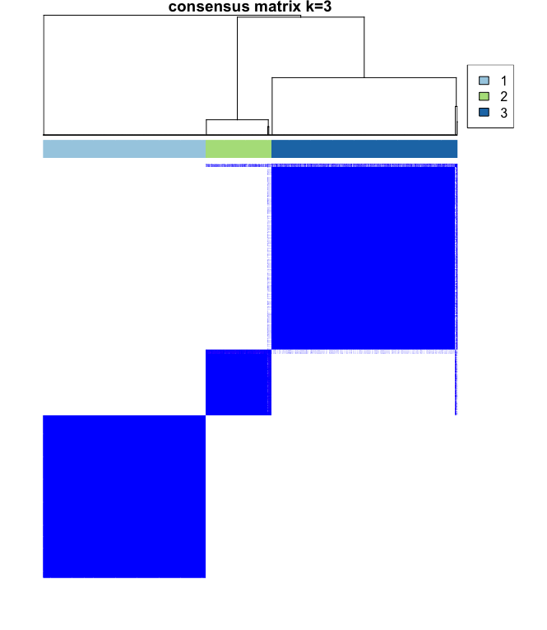
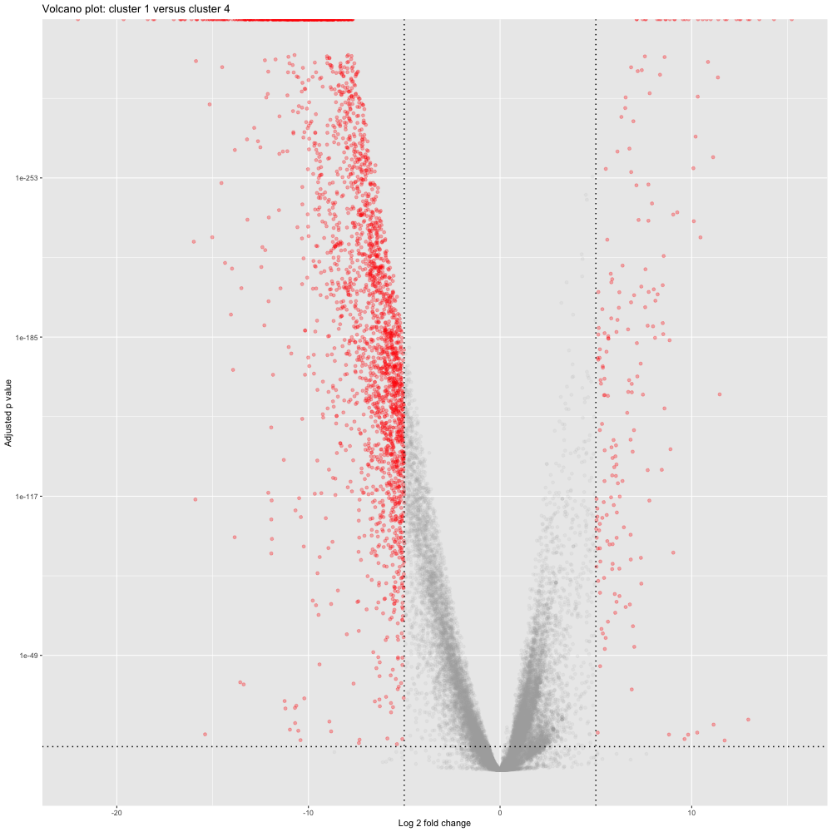
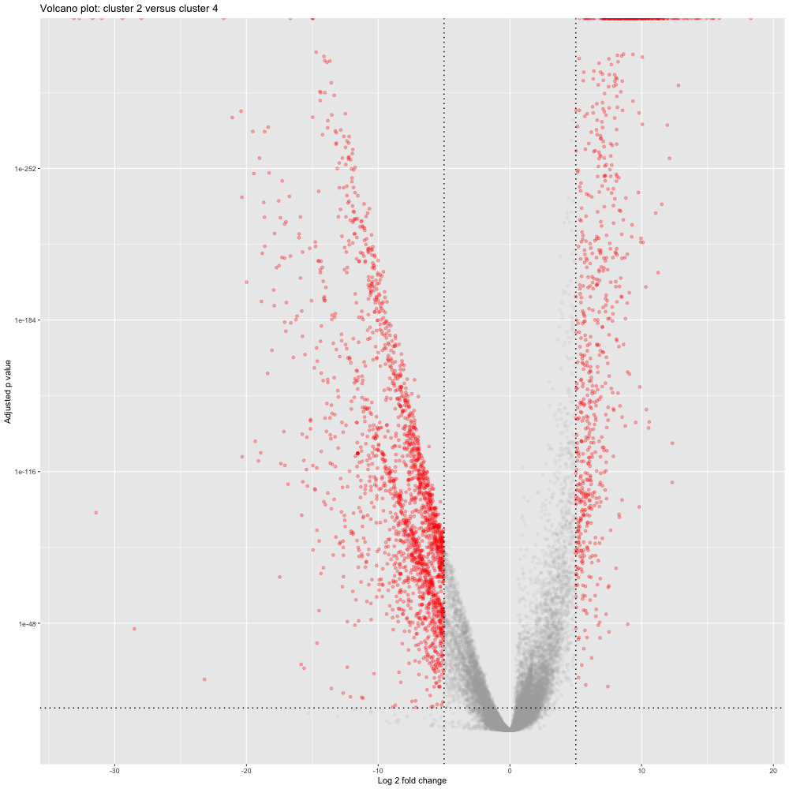
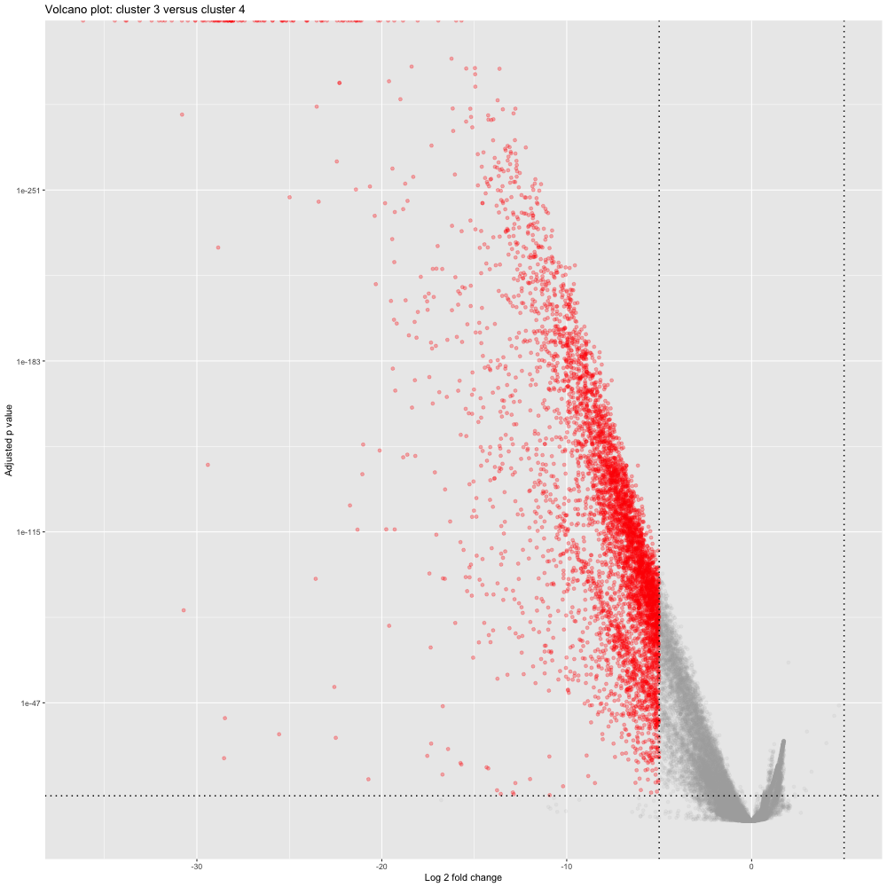
Clustering analysis of AD and PD
Cluster 1 vs control
Cluster 2 vs control
Cluster 3 vs control
Notes:
Rationale: AD and PD are both ageing-related, so combining datasets should reveal ageing-related biomarkers
Counts from ROSMAP, GSE20295, Reza’s dataset were combined and normalised
Fourth cluster added as a control – controls from all three datasets
Characterising the three clusters: DESeq shows: 1) mildly downregulated, 2) up- and downregulated, 3) heavily downregulated

Slide 3
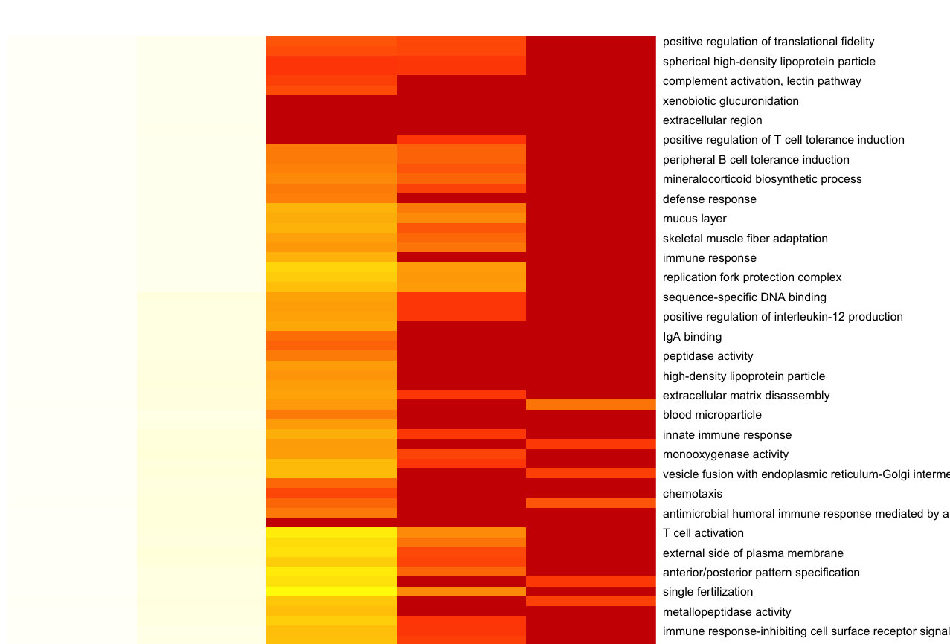
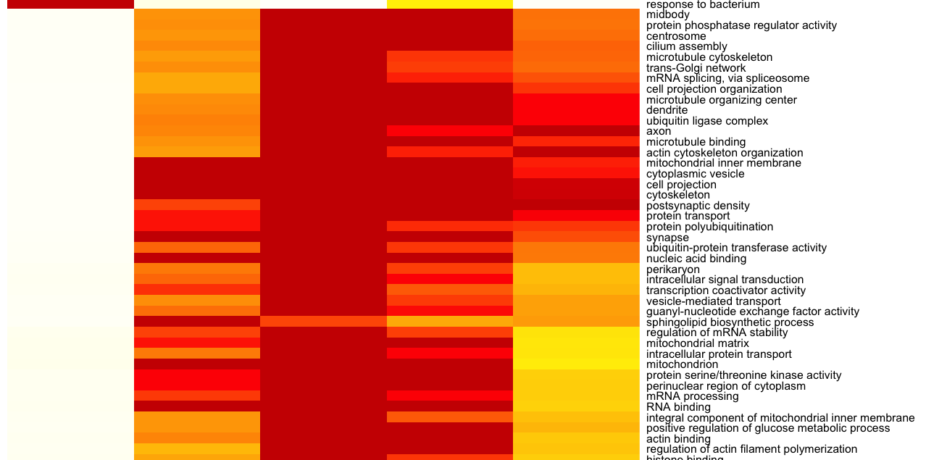
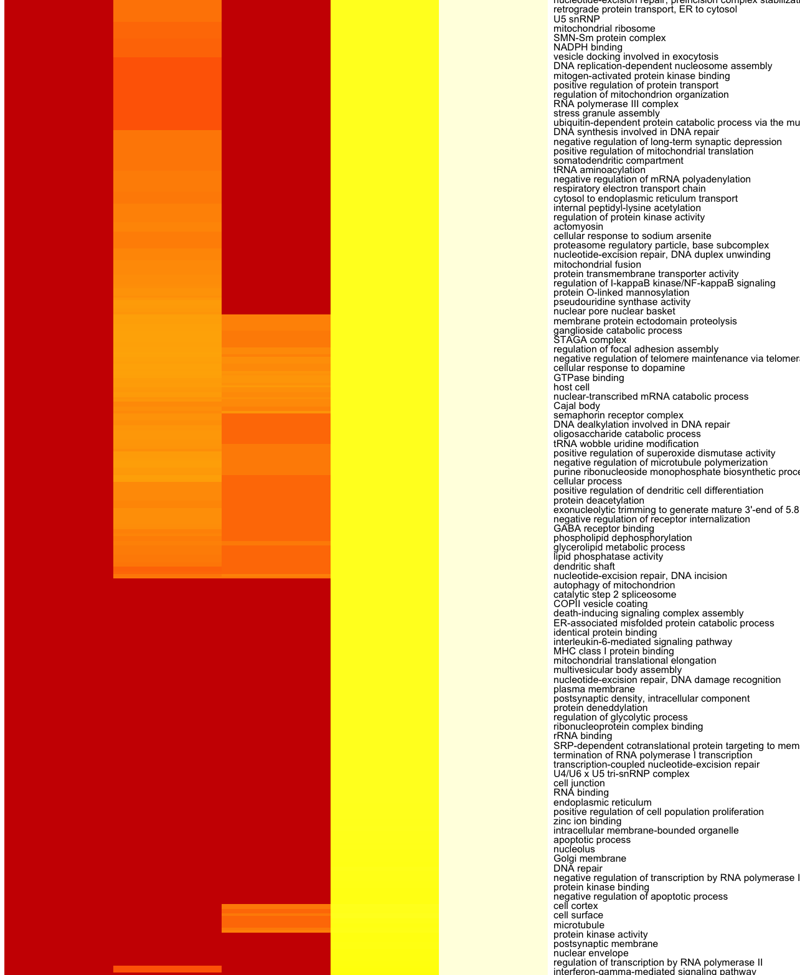
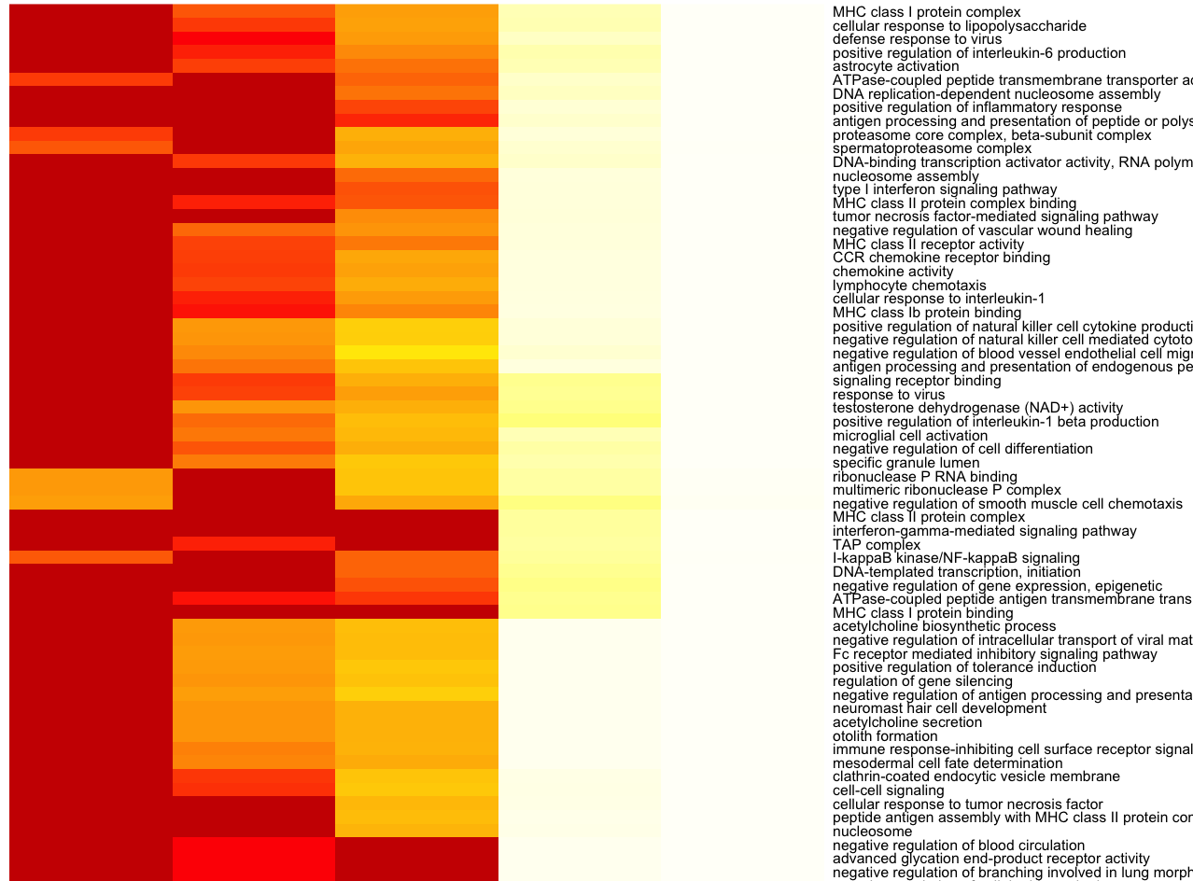
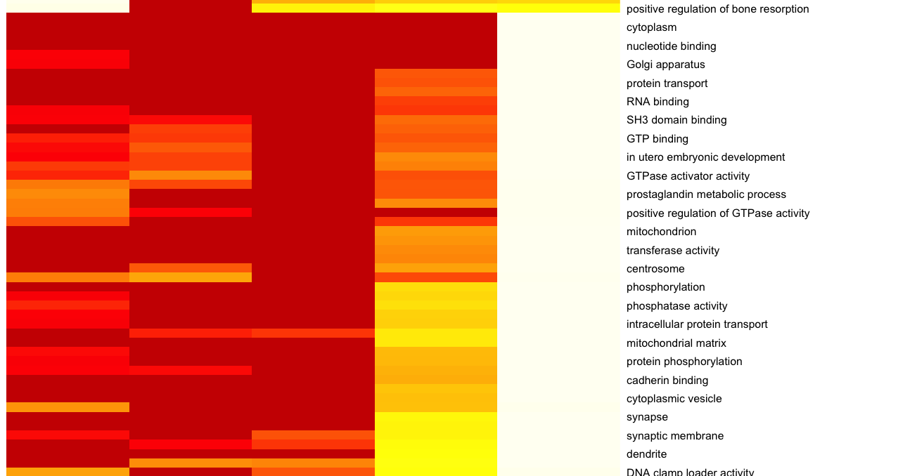
Gene set enrichment analysis
Cluster 1 vs control
Cluster 2 vs control
Cluster 3 vs control
…
…
…
Dist (dn)
Mix (dn)
Non-dir
Mix (up)
Dist (up)
Dist (dn)
Mix (dn)
Non-dir
Mix (up)
Dist (up)
Dist (dn)
Mix (dn)
Non-dir
Mix (up)
Dist (up)
Notes:
Gene set enrichment analysis
In line with differential expression results
All showed some GO terms upregulated and downregulated compared to control, except for cluster 3

Slide 4
Gene set enrichment analysis
Cluster 1 vs control
Cluster 2 vs control
Cluster 3 vs control
None significant
…
Cytoskeleton
Eye development
Telomere binding
Amino acid synthesis
Cell signalling
Immune signalling
…
…
Ion binding
Ion transport
Neuron differentiation
Cell membrane
Ion binding
Apoptosis
Inflammatory response
Cytoskeleton
Neuron development
Dist (dn)
Mix (dn)
Non-dir
Mix (up)
Dist (up)
Dist (dn)
Mix (dn)
Non-dir
Mix (up)
Dist (up)
Dist (dn)
Mix (dn)
Non-dir
Mix (up)
Dist (up)
Notes:
Gene set enrichment analysis
Identify cytoskeleton GO terms as down in cluster 1 but up in cluster 2
Cluster 2 also identifies increase in telomere binding activity – links to ageing

Slide 5
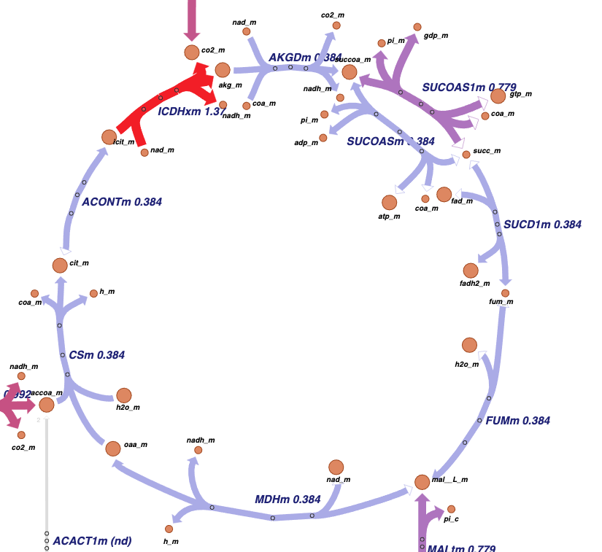
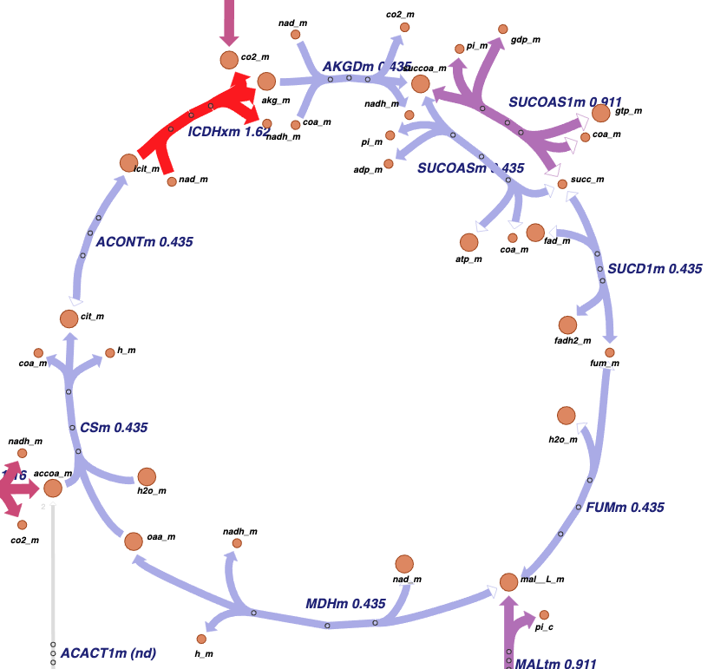
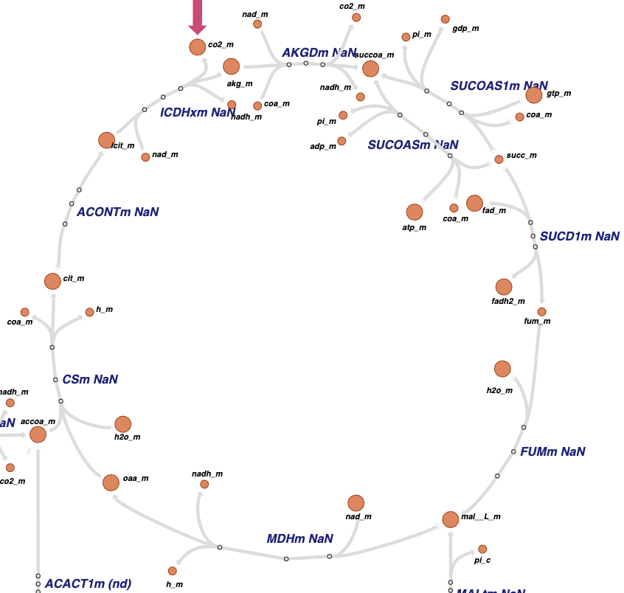
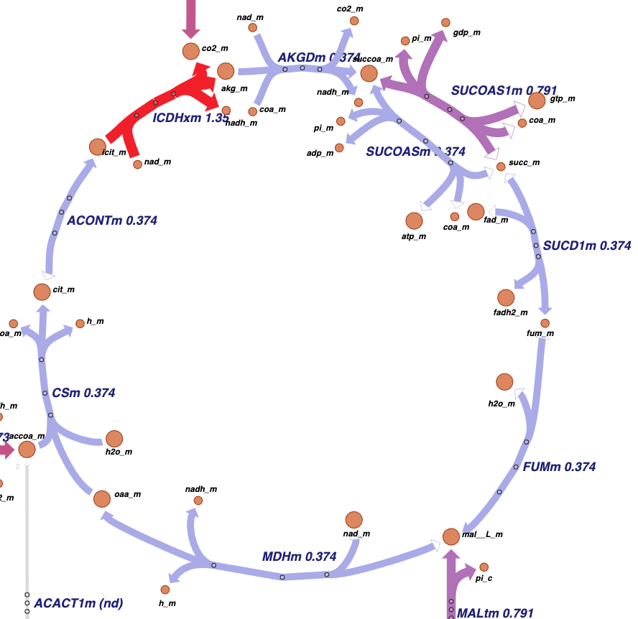
Quantification of metabolic functions (1)
Cluster 1
Cluster 2
Cluster 3
Control
Notes:
CellFie, TCA cycle
Clusters 1 and 2 resemble control – cluster 2 has slightly higher fluxes overall
Cluster 3 has no detected flux through TCA cycle – data quality issue

Slide 6
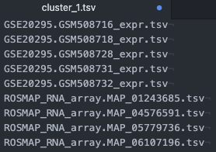
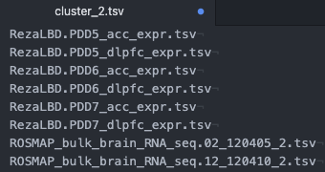
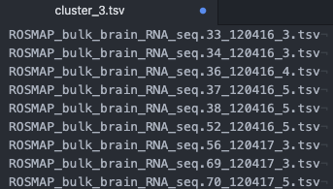
Quantification of metabolic functions (1)
Cluster 1
Cluster 2
Cluster 3
Control
Notes:
Cluster membership:
1 – GSE20295 (substantia nigra, prefrontal cortex, putamen) + ROSMAP (DLPFC)
2 – Reza’s dataset (anterior cingulate cortex, DLPFC) + ROSMAP
3 – ROSMAP only

Slide 7
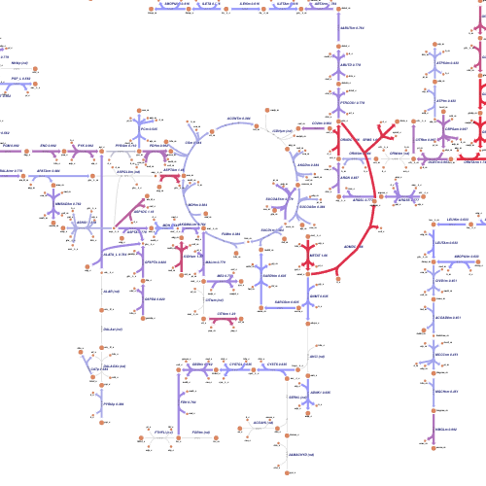
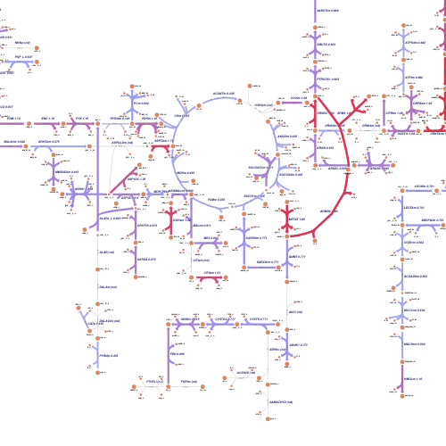
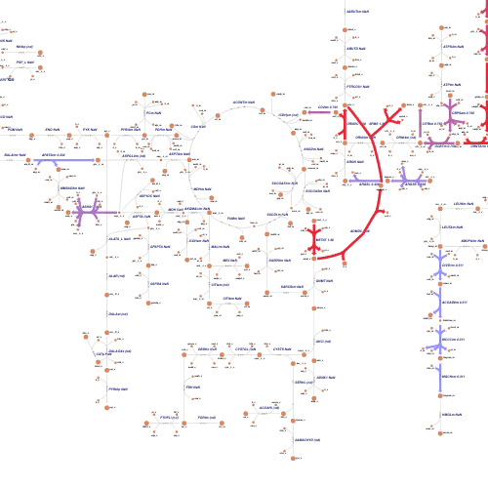
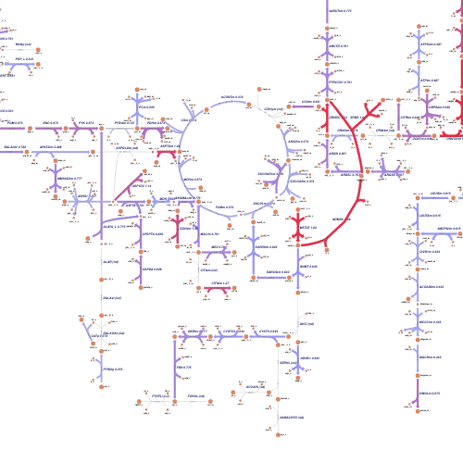
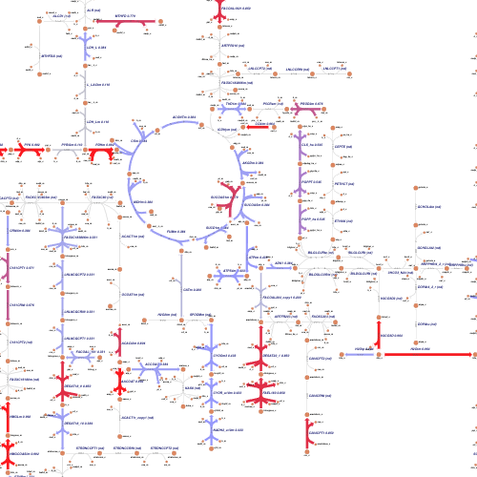
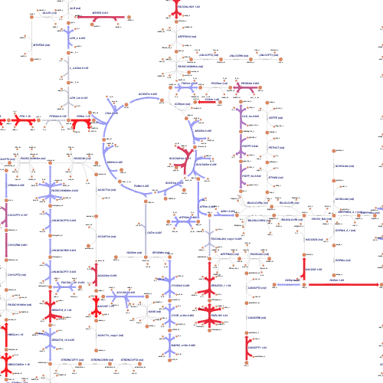
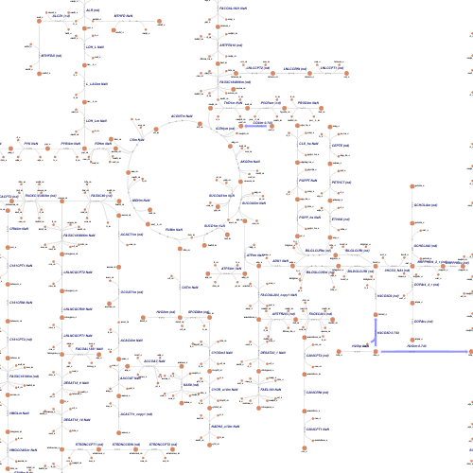
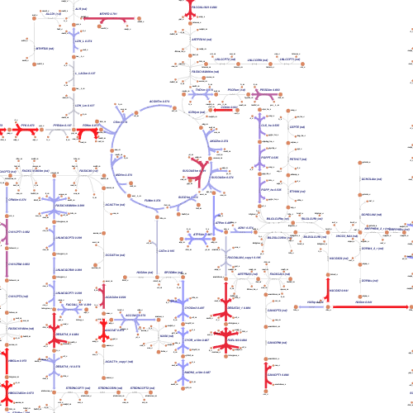
Quantification of metabolic functions (2)
Cluster 1
Cluster 2
Cluster 3
Control
Notes:
Top, amino acid metabolism
Bottom, lipid metabolism
C1 and C2 CellFies look like control
C3 almost no flux predicted

Slide 8
GEMs analysis
Cluster 1 vs control
Cluster 2 vs control
Cluster 3 vs control
ID | NAME | Z-SCORE | P-VALUE
m02630c | O2 | 4.1022 | 2.0463E-05
m02833c | retinoate | 3.7328 | 9.4695E-05
m02040s | H2O | 3.5852 | 0.00016842
m02554r | NADP+ | 3.5079 | 0.00022581
m02555r | NADPH | 3.5079 | 0.00022581
m01362c | arachidonate | 3.4622 | 0.00026792
m02630r | O2 | 3.4471 | 0.00028329
m01790c | estrone | 3.4402 | 0.00029059
m02833r | retinoate | 3.3713 | 0.00037409
m00380c | 15(S)-HPETE | 3.3705 | 0.00037509
m02188c | isoputreanine | 3.2836 | 0.00051239
m02811c | putreanine | 3.2836 | 0.00051239
m02919c | spermic acid 1 | 3.2836 | 0.00051239
m02921c | spermidine monoaldehyde 1 | 3.2836 | 0.00051239
m02922c | spermidine monoaldehyde 2 | 3.2836 | 0.00051239
m02925c | spermine monoaldehyde | 3.2836 | 0.00051239
ID | NAME | Z-SCORE | P-VALUE
m02419c | L-threonyl-tRNA(thr) | 3.6933 | 0.0001107
m03079c | tRNA(thr) | 3.6933 | 0.0001107
m02600c | N-methylethanolamine-phosphate | 3.3755 | 0.00036844
m02739c | phosphodimethylethanolamine | 3.3755 | 0.00036844
m02822c | quinolinate | 3.3399 | 0.00041903
m01921g | Gal-Xyl-L-Ser-[protein] | 3.2373 | 0.0006033
m01598m | cob(I)alamin | 3.1772 | 0.00074342
m01599m | cob(II)alamin | 3.1772 | 0.00074342
m01600m | cobamide-coenzyme | 3.1772 | 0.00074342
m03057m | triphosphate | 3.1772 | 0.00074342
m01268m | activation-ppara | 3.173 | 0.00075449
m02131c | HMG-CoA | 3.0881 | 0.0010071
m01759c | D-xylulose | 3.0373 | 0.0011937
 | …
m00290c | 11-cis-retinal | 2.6013 | 0.0046432
m01232c | 9-cis-retinol | 2.6013 | 0.0046432
ID | NAME | Z-SCORE | P-VALUE
m02838c | retinyl-ester | 3.7472 | 8.9425E-05
m00291c | 11-cis-retinol | 3.3653 | 0.00038233
m00292c | 11-cis-retinyl-palmitate | 3.3653 | 0.00038233
m00535c | 1-lysolecithin pool | 3.3653 | 0.00038233
m02834c | retinol | 3.3111 | 0.00046464
m02039s | H+ | 2.708 | 0.0033841
m02819m | pyruvate | 2.6064 | 0.0045747
m00234s | 1,2-diacylglycerol-chylomicron pool | 2.5795 | 0.0049474
m00235c | 1,2-diacylglycerol-LD-PC pool | 2.5795 | 0.0049474
m00236c | 1,2-diacylglycerol-LD-PE pool | 2.5795 | 0.0049474
m00238c | 1,2-diacylglycerol-LD-PS pool | 2.5795 | 0.0049474
m00239c | 1,2-diacylglycerol-LD-SM pool | 2.5795 | 0.0049474
m00503s | 1-acylglycerol-chylomicron pool | 2.5795 | 0.0049474
m00504c | 1-acylglycerol-LD-PC pool | 2.5795 | 0.0049474
m00505c | 1-acylglycerol-LD-PE pool | 2.5795 | 0.0049474
m00506c | 1-acylglycerol-LD-PI pool | 2.5795 | 0.0049474
Notes:
Constructed GEMs, using a modified iAdipocytes GEM as a reference
Reporter metabolites
Retinoids identified in all - links to ageing

Slide 9

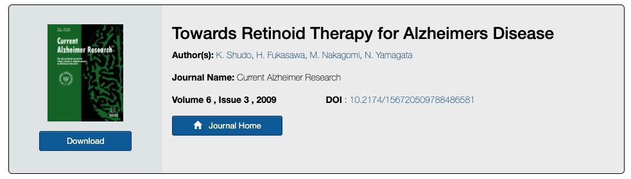
GEMs analysis
Cluster 1 vs control
Cluster 2 vs control
Cluster 3 vs control
ID | NAME | Z-SCORE | P-VALUE
m02630c | O2 | 4.1022 | 2.0463E-05
m02833c | retinoate | 3.7328 | 9.4695E-05
m02040s | H2O | 3.5852 | 0.00016842
m02554r | NADP+ | 3.5079 | 0.00022581
m02555r | NADPH | 3.5079 | 0.00022581
m01362c | arachidonate | 3.4622 | 0.00026792
m02630r | O2 | 3.4471 | 0.00028329
m01790c | estrone | 3.4402 | 0.00029059
m02833r | retinoate | 3.3713 | 0.00037409
m00380c | 15(S)-HPETE | 3.3705 | 0.00037509
m02188c | isoputreanine | 3.2836 | 0.00051239
m02811c | putreanine | 3.2836 | 0.00051239
m02919c | spermic acid 1 | 3.2836 | 0.00051239
m02921c | spermidine monoaldehyde 1 | 3.2836 | 0.00051239
m02922c | spermidine monoaldehyde 2 | 3.2836 | 0.00051239
m02925c | spermine monoaldehyde | 3.2836 | 0.00051239
ID | NAME | Z-SCORE | P-VALUE
m02419c | L-threonyl-tRNA(thr) | 3.6933 | 0.0001107
m03079c | tRNA(thr) | 3.6933 | 0.0001107
m02600c | N-methylethanolamine-phosphate | 3.3755 | 0.00036844
m02739c | phosphodimethylethanolamine | 3.3755 | 0.00036844
m02822c | quinolinate | 3.3399 | 0.00041903
m01921g | Gal-Xyl-L-Ser-[protein] | 3.2373 | 0.0006033
m01598m | cob(I)alamin | 3.1772 | 0.00074342
m01599m | cob(II)alamin | 3.1772 | 0.00074342
m01600m | cobamide-coenzyme | 3.1772 | 0.00074342
m03057m | triphosphate | 3.1772 | 0.00074342
m01268m | activation-ppara | 3.173 | 0.00075449
m02131c | HMG-CoA | 3.0881 | 0.0010071
m01759c | D-xylulose | 3.0373 | 0.0011937
 | …
m00290c | 11-cis-retinal | 2.6013 | 0.0046432
m01232c | 9-cis-retinol | 2.6013 | 0.0046432
ID | NAME | Z-SCORE | P-VALUE
m02838c | retinyl-ester | 3.7472 | 8.9425E-05
m00291c | 11-cis-retinol | 3.3653 | 0.00038233
m00292c | 11-cis-retinyl-palmitate | 3.3653 | 0.00038233
m00535c | 1-lysolecithin pool | 3.3653 | 0.00038233
m02834c | retinol | 3.3111 | 0.00046464
m02039s | H+ | 2.708 | 0.0033841
m02819m | pyruvate | 2.6064 | 0.0045747
m00234s | 1,2-diacylglycerol-chylomicron pool | 2.5795 | 0.0049474
m00235c | 1,2-diacylglycerol-LD-PC pool | 2.5795 | 0.0049474
m00236c | 1,2-diacylglycerol-LD-PE pool | 2.5795 | 0.0049474
m00238c | 1,2-diacylglycerol-LD-PS pool | 2.5795 | 0.0049474
m00239c | 1,2-diacylglycerol-LD-SM pool | 2.5795 | 0.0049474
m00503s | 1-acylglycerol-chylomicron pool | 2.5795 | 0.0049474
m00504c | 1-acylglycerol-LD-PC pool | 2.5795 | 0.0049474
m00505c | 1-acylglycerol-LD-PE pool | 2.5795 | 0.0049474
m00506c | 1-acylglycerol-LD-PI pool | 2.5795 | 0.0049474
Notes:
Constructed GEMs, using a modified iAdipocytes GEM as a reference
Reporter metabolites
Retinoids identified in all - links to ageing

Slide 10
Next steps
Investigate any possible data quality issues in cluster 3
Investigate the significance of retinoids as a reporter metabolite
Repeat the analysis on brain regions rather than unsupervised clusters (dependent on data)
Repeat the analysis on the zebrafish model of ageing

Slide 11

Adil Mardinoglu Muhammad Arif Rui Benfeitas Robert Knight Hanzhong Bai
Yulia Brodskaya, 2015, “MindBrain”
Thank you
Multi-omics brain map of Parkinson’s disease
Simon Lam
Centre for Host-Microbiome Interactions
Floor 18, Tower Wing
simon.1.lam@kcl.ac.uk
Simon Lam
Faculty of Dentistry, Oral & Craniofacial Sciences
Update meeting 13/8/20
© 2020 King’s College London. All rights reserved

